Slide 1
Robot Arm
Fall 2015: CSCI 3308 Project
Bradley Arnot, Andrew Candelaresi, Kelsey Dowd, Lauren Mitchell

Slide 2

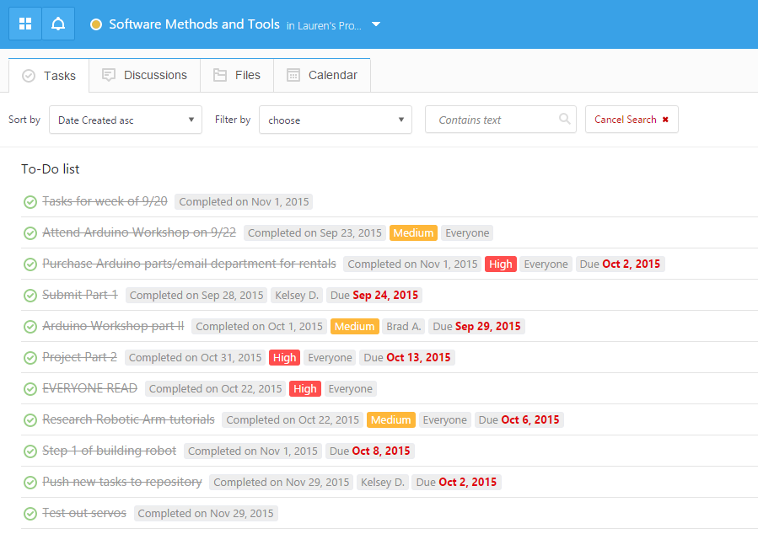
Project Tracker Rating: 2
Good for keeping track of individual and group tasks
Not easy to make public
To-Do List is visually overwhelming
Calendar feature was not very helpful to us

Slide 3
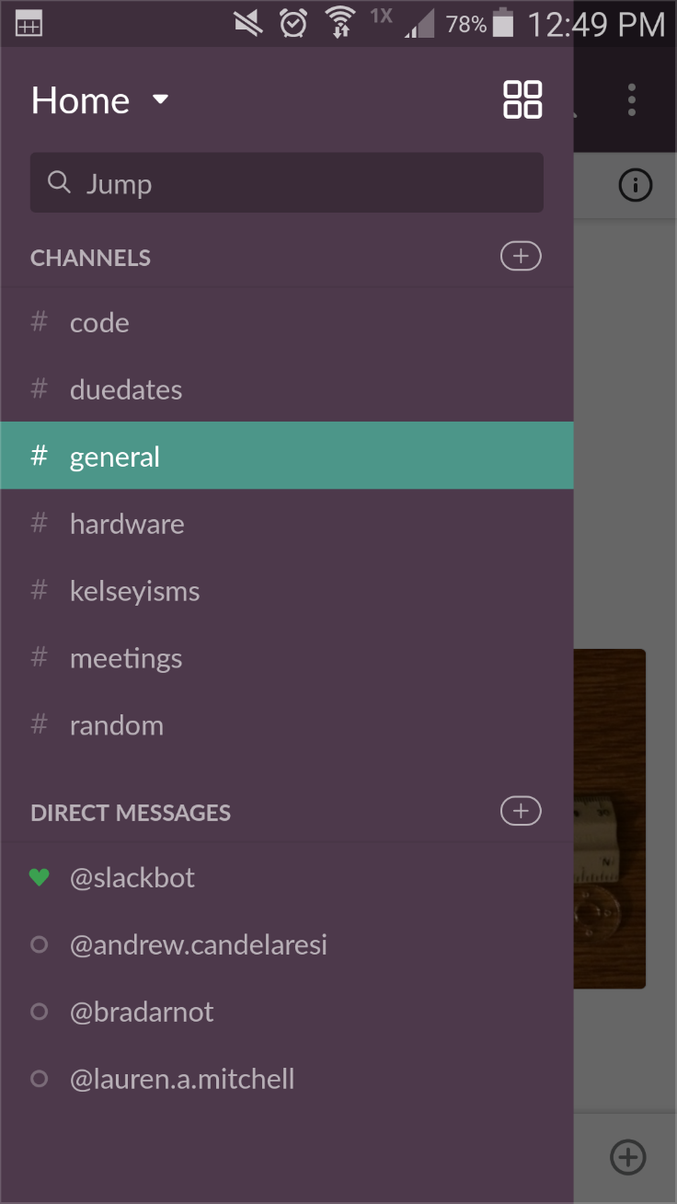
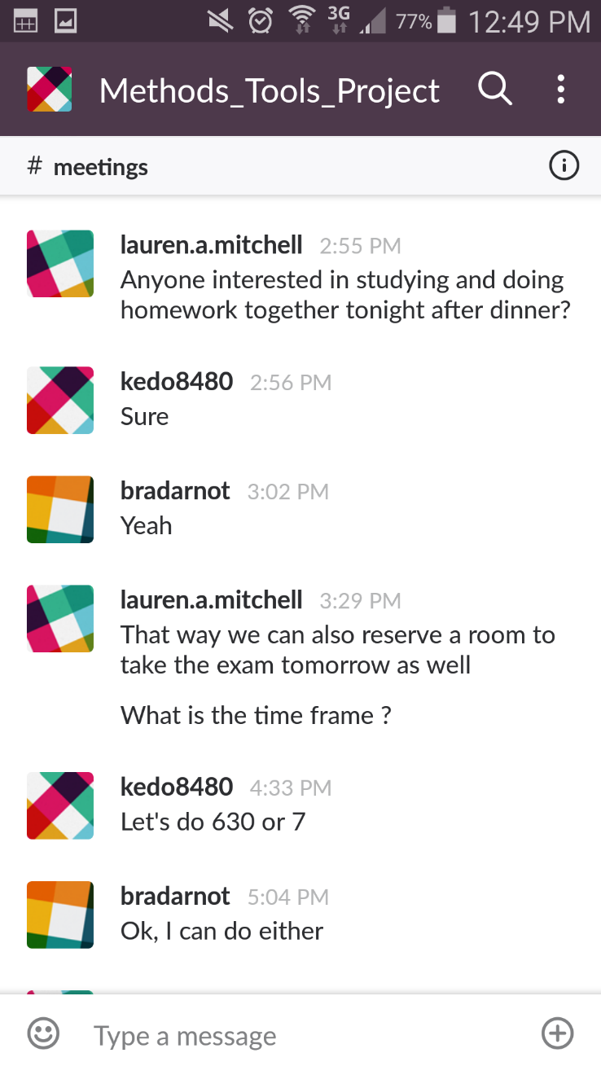

Project Tracker Rating: 5
Used for communication purposes
Helps to organize different conversation topics
SMS notifications allow for fast response

Slide 4

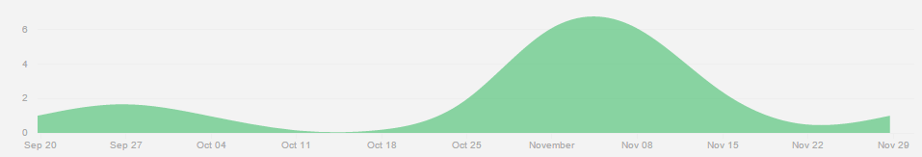
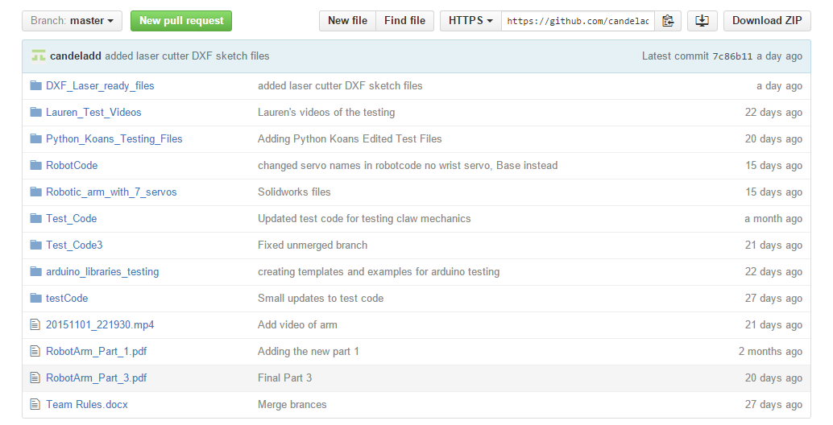
VCS Rating: 4
Great version control
There is a size-limit of files you can push to the repository
Can’t push long videos

Slide 5
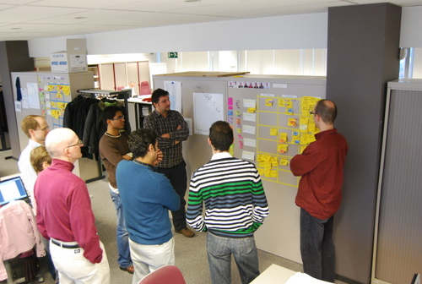
Development Methodology
Agile
2 week sprints
Weekly Scrum meetings
Bi-weekly retrospectives

Slide 6
Testing
Python Koans
Single unit tests using asserts in python
Arduino Unit Tests
Tested certain features on Arduino
Read in the Serial Port whether or not it passed or failed
Notes:
Lauren

Slide 7

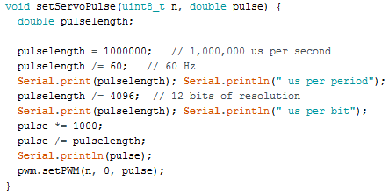
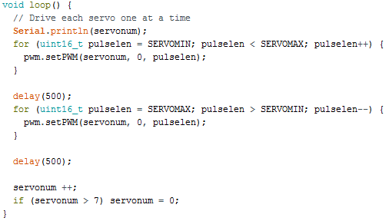
Open Source IDE allows for easy interaction with hardware
Mixture between C++ and Java
Took introductory courses at the ITLL: Intro and Motion I
Notes:
BRAD

Slide 8

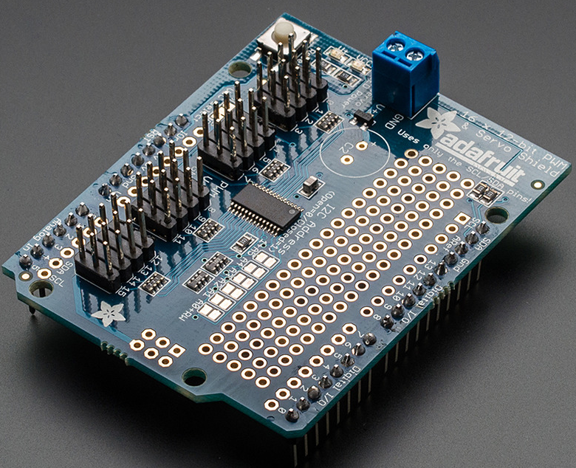
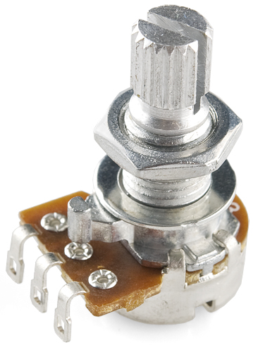
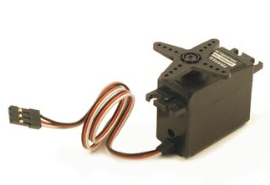
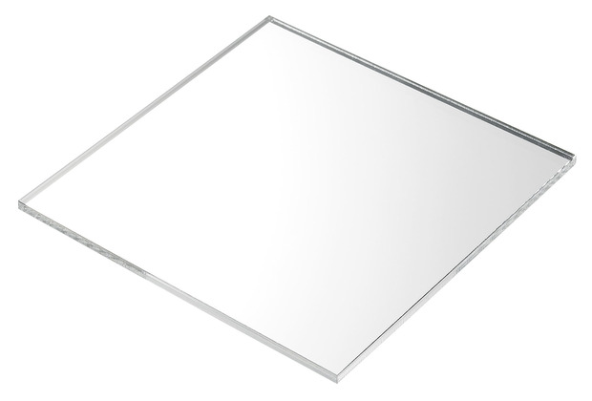
Arduino Uno
Servo Shield
Potentiometers
Servos
Acrylic
Notes:
Kelsey

Slide 9

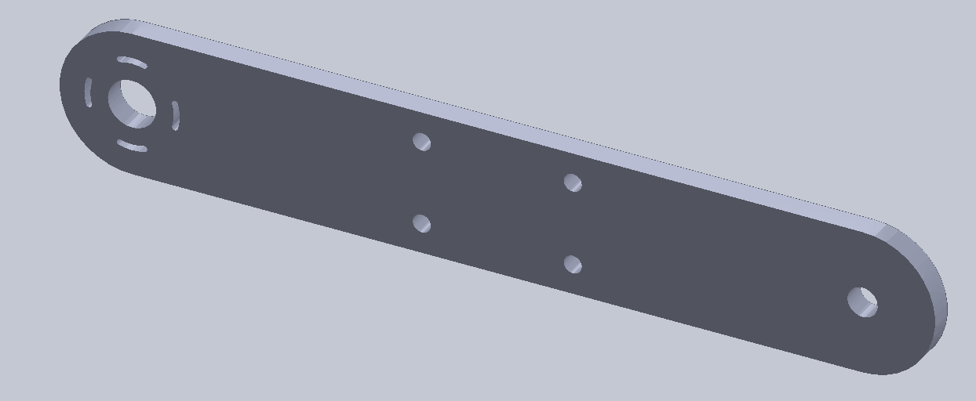
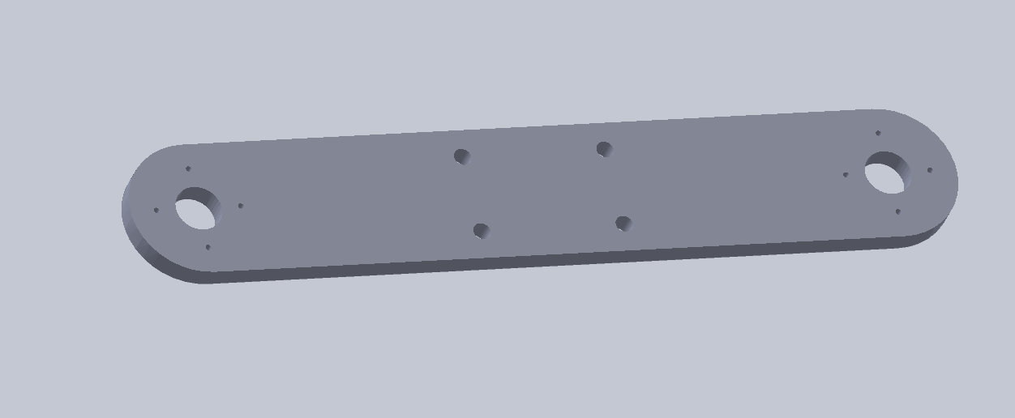
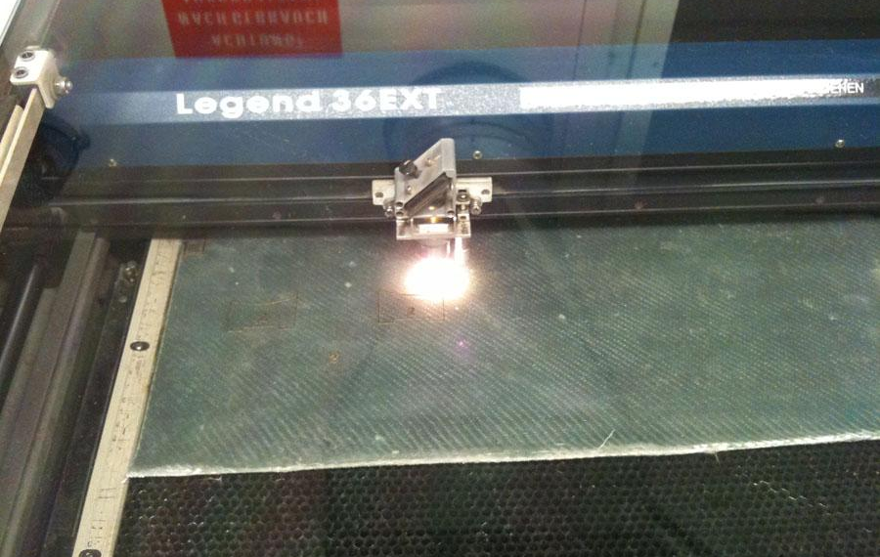
Used SolidWorks to design arm pieces and laser cut them using 0.095 in thick acrylic
Notes:
Andrew

Slide 10
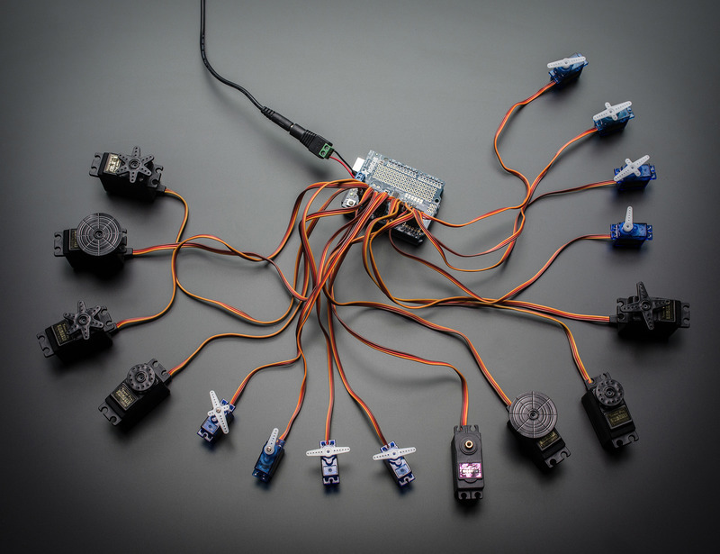
Challenges
Blocked by constantly having to order new parts
Learning experience
Scaling/Power issues – one servo vs. five servos

Slide 11
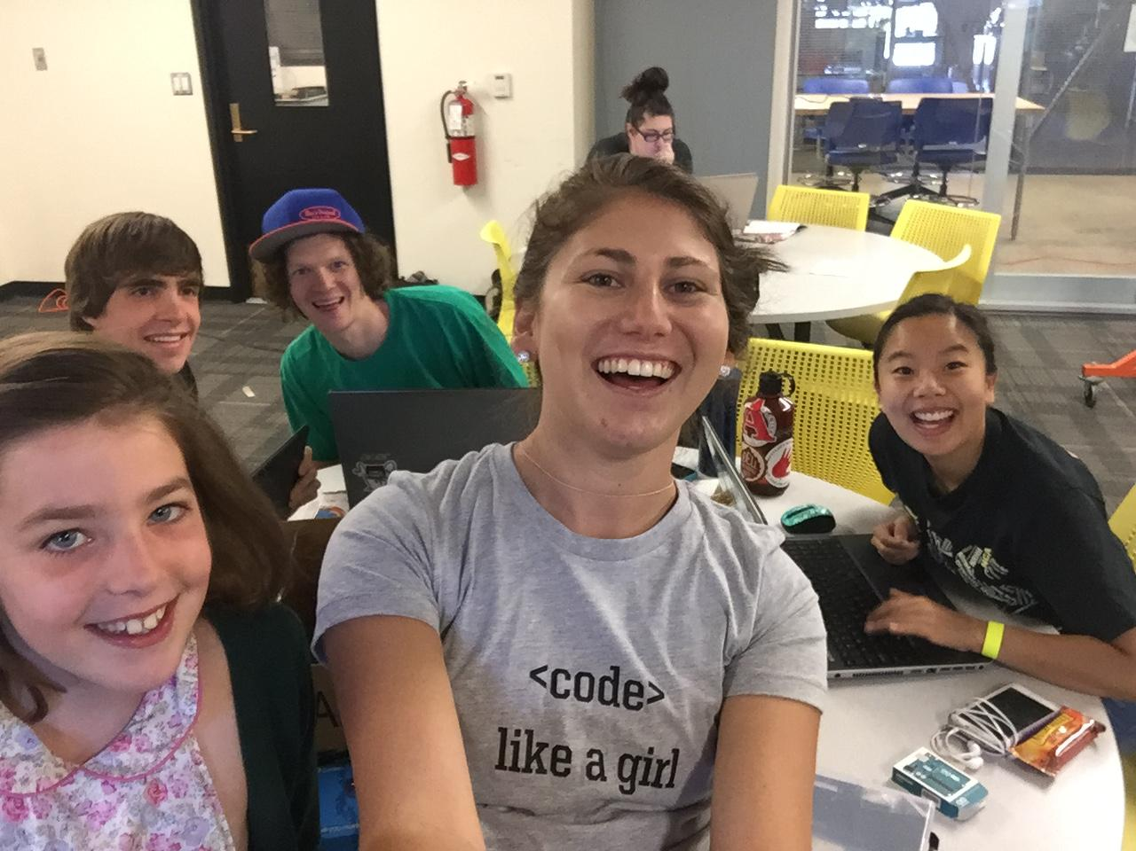
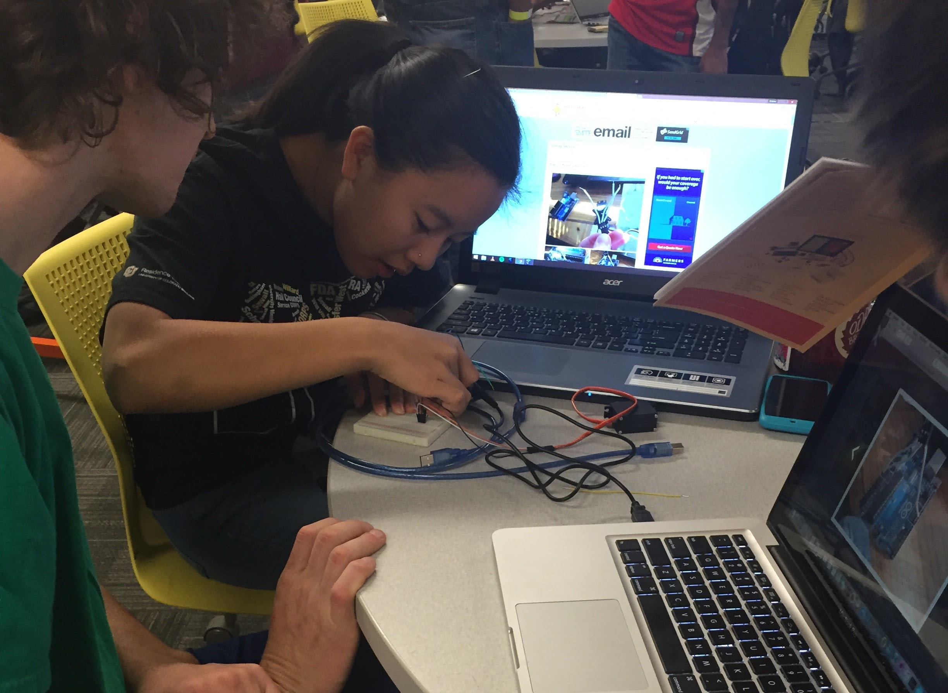
Project Demo
Pictures from CU Local Hack Day

Slide 12
Youtube Demos
4 servos on servo sheild
Claw, Upper, and Lower Arm

